Slide 1
CSE 2500: Introduction to Discrete Systems
Lecture 16: Mathematical Induction Part 2
Kaleel Mahmood
Department of Computer Science and Engineering
University of Connecticut

Slide 2
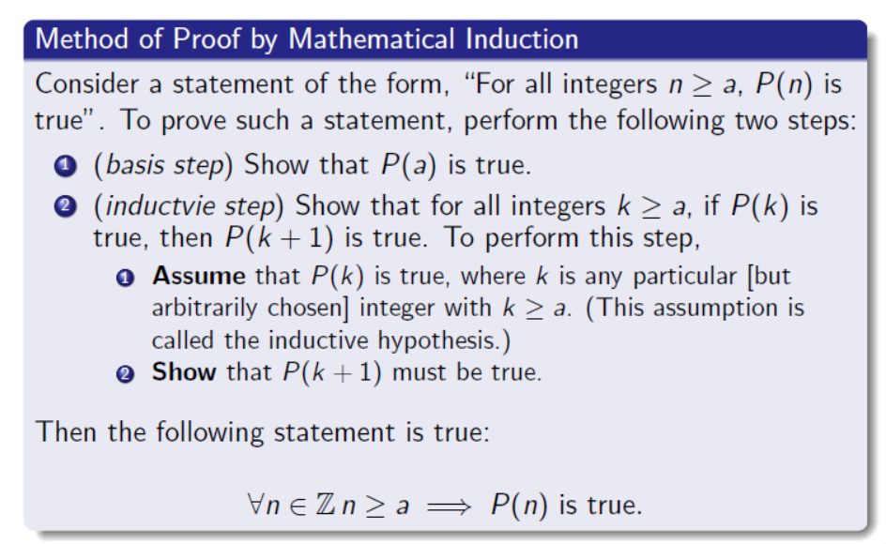

Slide 3
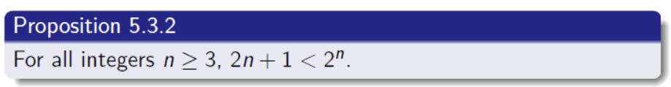
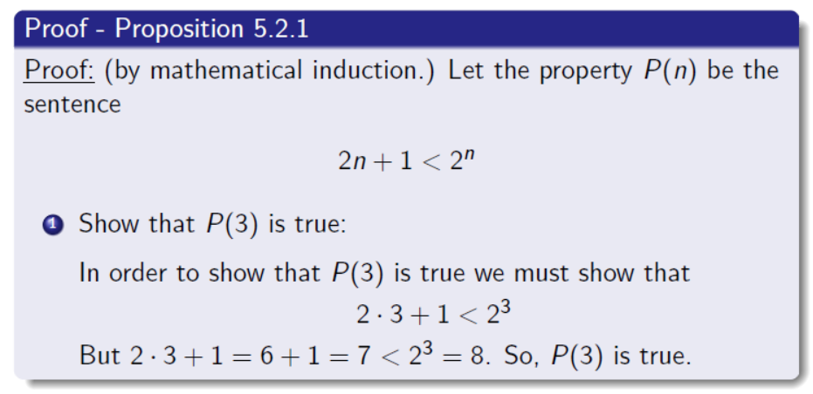

Slide 4
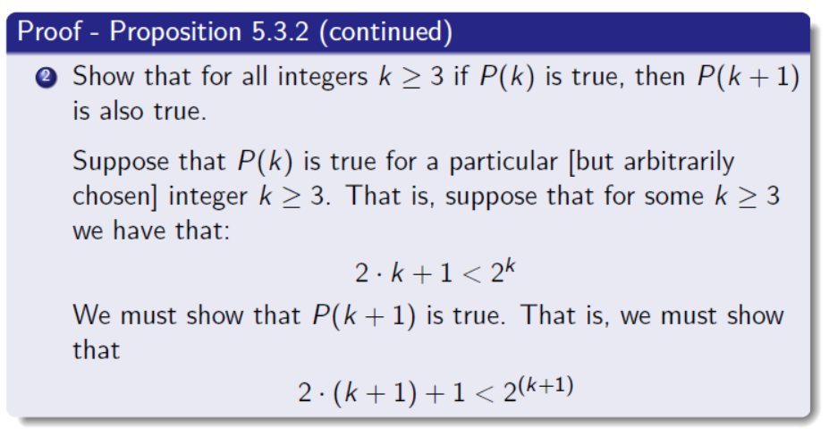

Slide 5
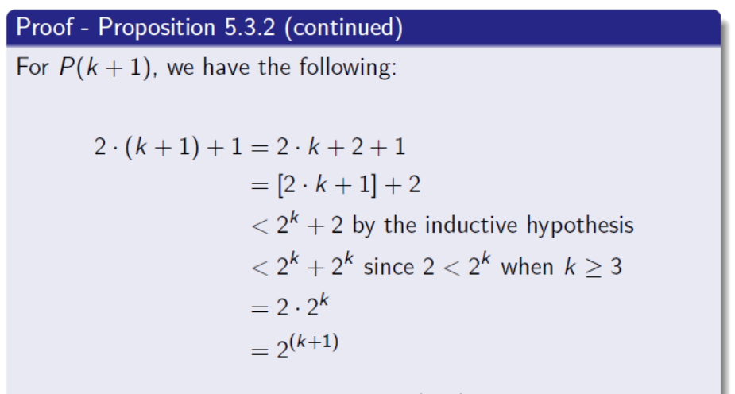
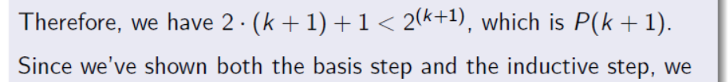
We can conclude that the theorem is true.

Slide 6
Whiteboard Example

Slide 7
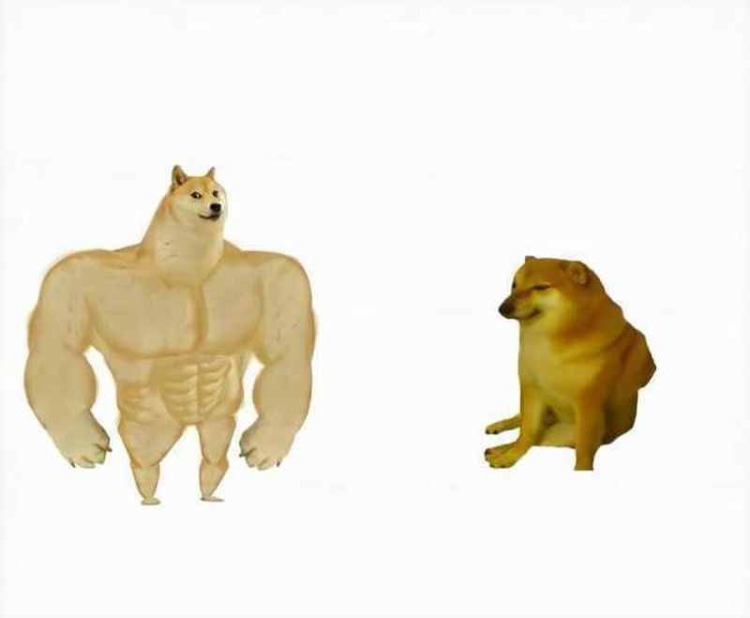
Next Topic…
STRONG Mathematical Induction
Mathematical Induction

Slide 8
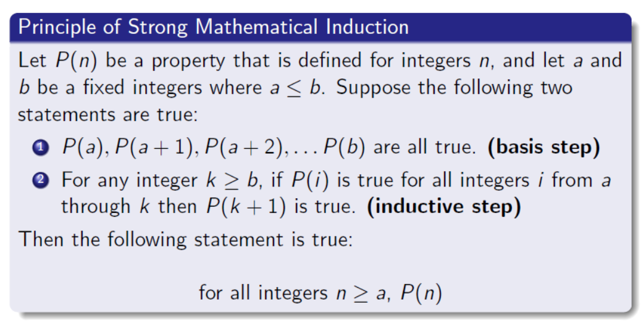
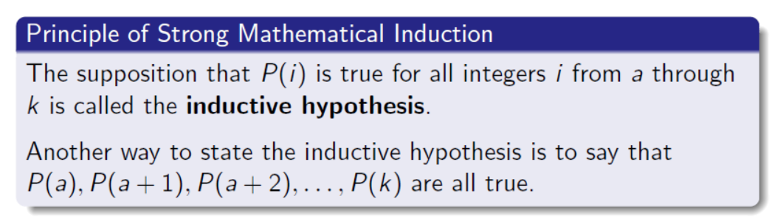

Slide 9
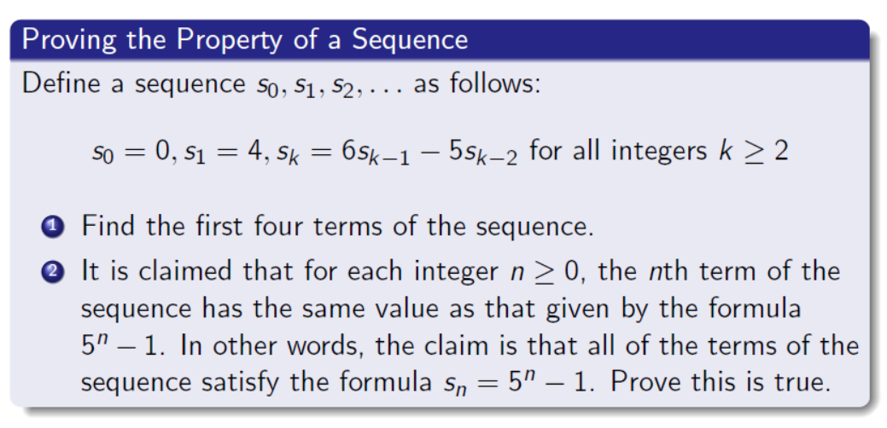
Strong Mathematical Induction Example

Slide 10
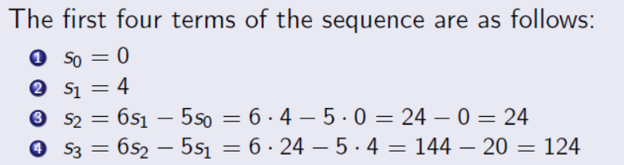

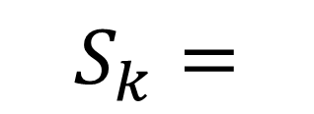
Before proving, first sketch the first few terms...
$$S_{k}=$$
$$S_{k}=5^{k}−1$$

Slide 11
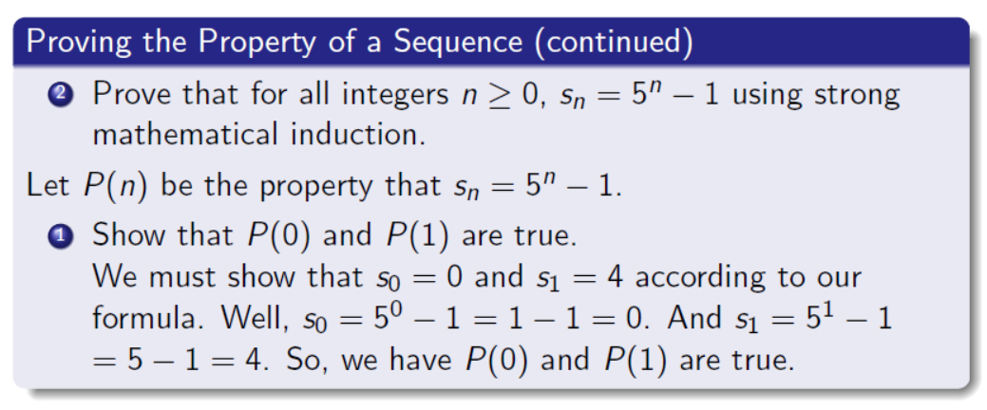
Strong Mathematical Induction Example

Slide 12
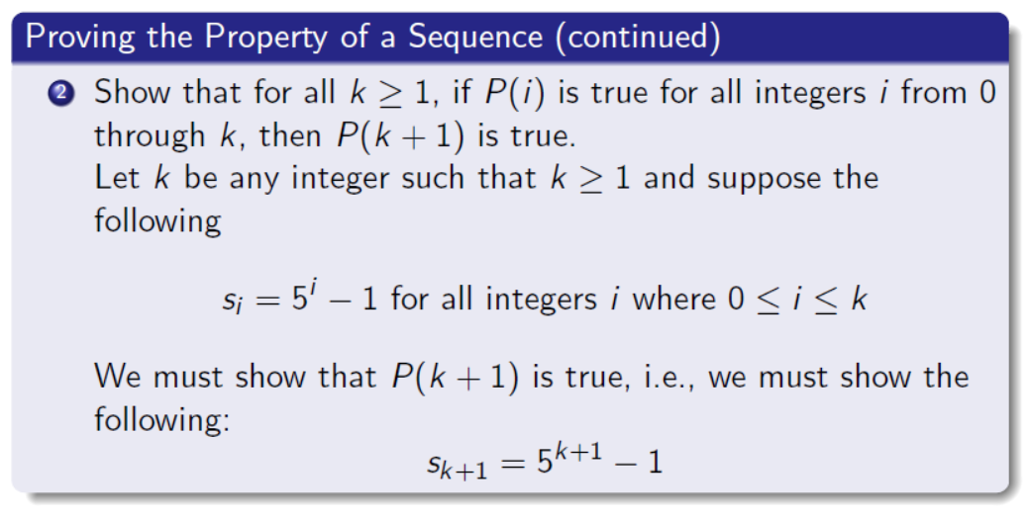
Strong Mathematical Induction Example

Slide 13
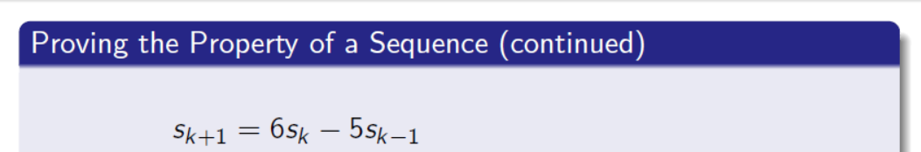
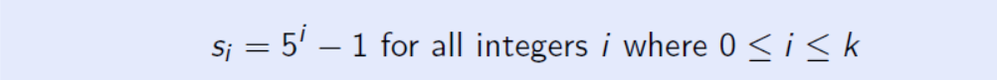



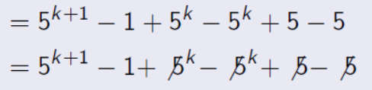
Do some simplification:

Slide 14
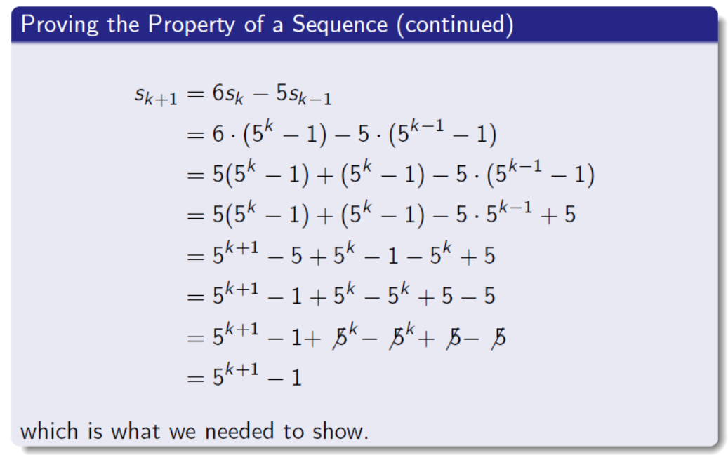
The whole picture:

Slide 15

Time for a riddle…
3,5,7… what is the next number in the sequence?
Actually its impossible to say without more information. Why?
The sequence could be the list of prime numbers starting at 3. So 3,5,7,11,…
The sequence could be the list of odd numbers starting at 3. So 3,5,7,9….

Slide 16
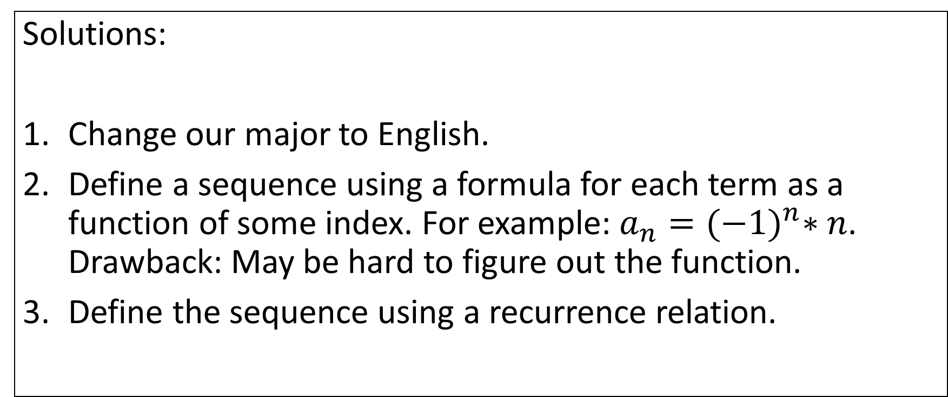
Question: How can we avoid ambiguous number sequences?
Solutions:
Change our major to English.
Define a sequence using a formula for each term as a function of some index. For example: $a_{n}={(−1)}^{n}∗n$. Drawback: May be hard to figure out the function.
Define the sequence using a recurrence relation.

Slide 17
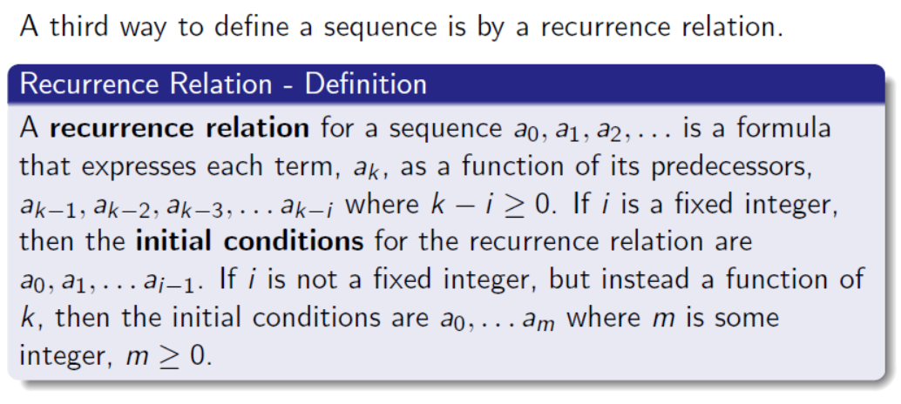

Slide 18
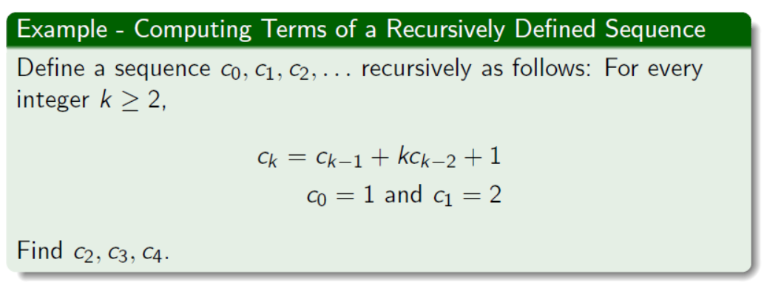
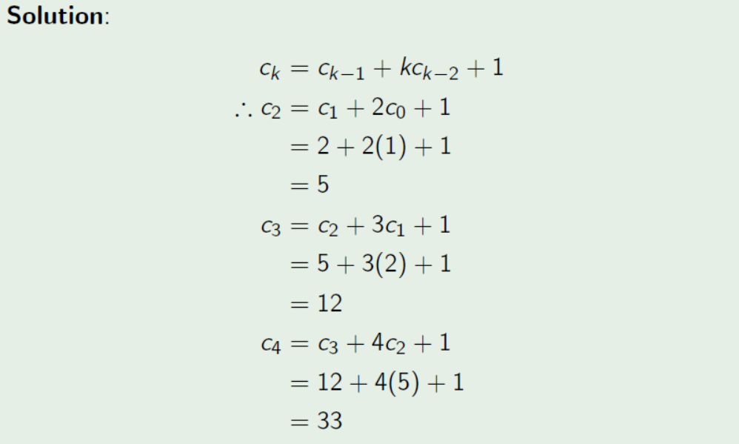

Slide 19
Figure Sources
https://cdn.kapwing.com/collections/strong-dog-vs-weak-dog-meme-template-5165m.jpg
https://static.wikia.nocookie.net/batman/images/a/a4/The_Riddler_%28BF%29.jpg/revision/latest?cb=20120718050811

